Slide 1
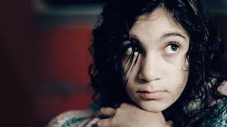
Popular Cinema and Emotional Response
Tanya Jones

Slide 2
Spectatorship
Within the study of Spectatorship:
The relationship between the text and the viewer is complex.
There exists a plurality of readings and subjectivity of response.
The viewer enters into a discourse with the text they are viewing.
The viewer’s ‘reading’ of a text could be preferred, negotiated or oppositional (Stuart Hall).

Slide 3
Key Questions within the spectatorship debate.
How does a film text aim to generate emotional response?
NB. The 5 modes of engagement below are often inter-woven.
Through its use of micro and macro elements. (These underpin all textual constructions).
Through viewer identification with a particular character or life event.
Through discussions of contentious issues, events or themes. (These could include drawing on historical events).
Through challenging the viewer’s assumptions or confirming their world view.
Through shocking the viewer, exciting them, angering them, manipulating them or making them cry.

Slide 4
Key Questions within the spectatorship debate.
2. Is the emotional impact of a film influenced by contextual or pre-existing knowledge?
The film might be based on true events.
‘Word of mouth’, critical and popular criticism might influence expectations.
Knowledge of the director, stars or genre could influence viewer response.
Knowledge of an original text eg. the book that inspired the film, could set up expectations.

Slide 5
Key Questions within the spectatorship debate.
3. Does the viewer’s age, gender, sexuality, ethnicity etc influence the viewer’s emotional response?
4. Does emotional response diminish when a film dates or with repeated viewings?
5. Is emotional response influenced by different viewing contexts?
6. Does being able to read a film critically impede emotional response?

Slide 6
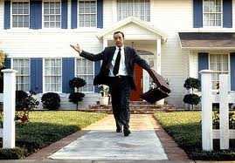
American Beauty (Sam Mendes 1999)

Slide 7
Emotional response and textual engagement strategies.
The mise en scene and framing combine to ‘imprison’ Lester, offering the viewer a reading of his state of mind.
The viewer is, therefore, encouraged to empathise and identify with Lester.
Lester’s non-diegetic voice-over is plaintive and looks back to a happier past.
The spatial and mise en scene contrast between Lester and the perfect house and garden, encourage the viewer to question/critique the ‘American Dream’.

Slide 8
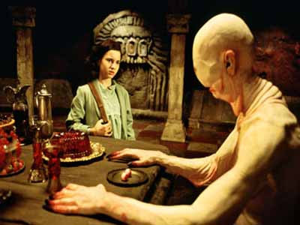
Pan’s Labyrinth (Guillermo del Toro 2006)

Slide 9
Emotional response and textual engagement strategies.
Genre recognition of horror and fairy tale codes.
Mise en scene of blood red food and bloodless monster.
The iconography of barbarity: the ‘Pale Man’ as Cronos & the pile of children’s shoes referencing the Holocaust.
Non-diegetic soundtrack of children coded as a horror motif by the hellish diegetic crackles of the fire and the children’s shoes.

Slide 10
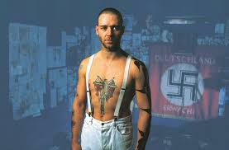
Romper Stomper (Geoffrey Wright 1992)

Slide 11
Emotional response and textual engagement strategies.
The diegetic sound moves to a non-diegetic bestial howl, presenting Hando as animal.
The cacophony of sound (diegetic and non-diegetic) disturbs the viewer.
Through the final POV shot, the viewer is identified with neo-Nazi Hando. Is this something that the viewer will accept or reject?
The mise en scene of the beautiful empty beach setting contrasts with the brutality of the killing and the blood.

Slide 12
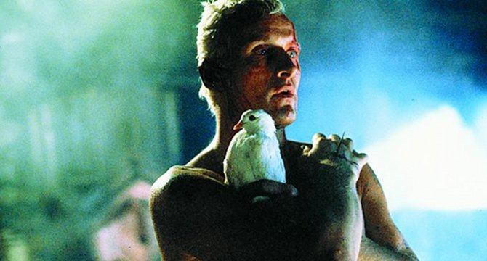
Blade runner (Ridley Scott 1982)

Slide 13
Emotional response and textual engagement strategies.
The final diegetic speech of the ‘replicant’ Roy is poetic and powerful. It encapsulates the beauty of life at the point of his death.
The light surrounding Roy in this sequence counters the dystopian neo-noir darkness of the mise en scene still attached to Deckard.
The slow motion at the point of death and release of the dove entrenches the text’s preferred meaning of Roy not as a killer but a character who understands that value of life more than the ‘humans’ in the film.

Slide 14
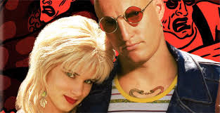
Natural Born Killers (Oliver Stone 1994)

Slide 15
Emotional response and textual engagement strategies.
Canted angles, opera music when the knife is thrown, shifts from black and white to colour all help to present a stylised sequence that seems surreal or cartoon.
The ‘rednecks’ are clearly presented as the antagonists.
They crush a scorpion with their truck.
There is a dead stag strapped to the truck.
Their language is misogynistic. “That’s some sweet piece of meat, aint it?” “I call it pussy.”
The romance sequence with La Vie en Rose as the soundtrack invites us to view Mickey and Malory in a softer light.

Slide 16
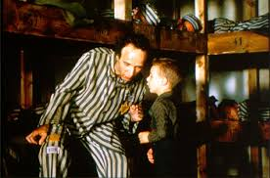
La Vita e Bella (Roberto Benigni 1997)

Slide 17
Emotional response and textual engagement strategies.
The death of Guido is off screen and the heightened diegetic sound of the gunshot is for shock effect.
Guido’s comic body language and diegetic speech are designed to diametrically oppose the reality of the situation for his son. The viewer is encouraged to react to this poignancy.
Do comedy and a subject like the the Holocaust mix?

Slide 18
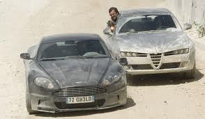
Quantum of Solace (Marc Forster 2008)

Slide 19
Emotional response and textual engagement strategies.
The opening sequence uses dramatic shifts in all micro elements to engage and excite the viewer.
Extreme long shots become a frenzy of close ups, mid-shots and long shots in the chase.
The pace of the editing dramatically accelerates as the viewer enters the chase.
The calm, serene and beautiful mise en scene becomes darker, grittier and battered.
The repeated refrain of the non-diegetic sound-track cuts to blunt, brutal and chaotic diegetic sounds.

Slide 20
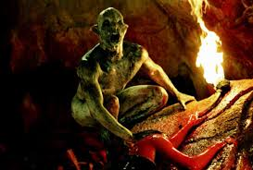
The Descent (Neil Marshall 2005 )

Slide 21
Emotional response and textual engagement strategies.
The genre literacy of the viewer is engaged in this scene.
The shift to hand held cinematography predicts a shocking revelation.
The cave walls tightly frame the women to imply that they are trapped and vulnerable.
Pools of light, shadows and darkness indicate imminent peril.
The viewer’s understanding of slasher conventions is utilised to imply that the group is diminishing and will continue to do so.

Slide 22
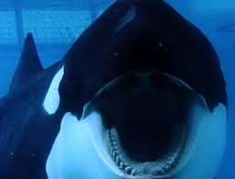
Blackfish (Gabriela Cowperthwaite 2013)

Slide 23
Emotional response and textual engagement strategies.
This film sequence challenges our assumptions about Orcas in captivity.
The viewer is encouraged to anchor their reading of the mother’s cries through the diegetic speech of the trainer.
The framing imprisons the whale.
The presentation of the mother/ child relationship is particularly emotive.

Slide 24
Let the Right One In (Tomas Alfredson 2008)

Slide 25
Emotional response and textual engagement strategies. Considerations.
An evolved vampire film eg. Eli breaks the usual visual codes of the vampire.
Character identification. The bullies are presented as the real villains of the film.
The vampire as a metaphor for exclusion. Identification and empathy.
The palette of the film is laden with binary opposites. Snow and darkness. Snow and blood. Beauty and danger.
Subtlety and silence. The soundscape of the film is as enigmatic and enthralling as the mise en scene.
The brutal, but satisfactory, narrative resolution.

Slide 26
Popular Cinema and Emotional Response
Tanya Jones

