Slide 1
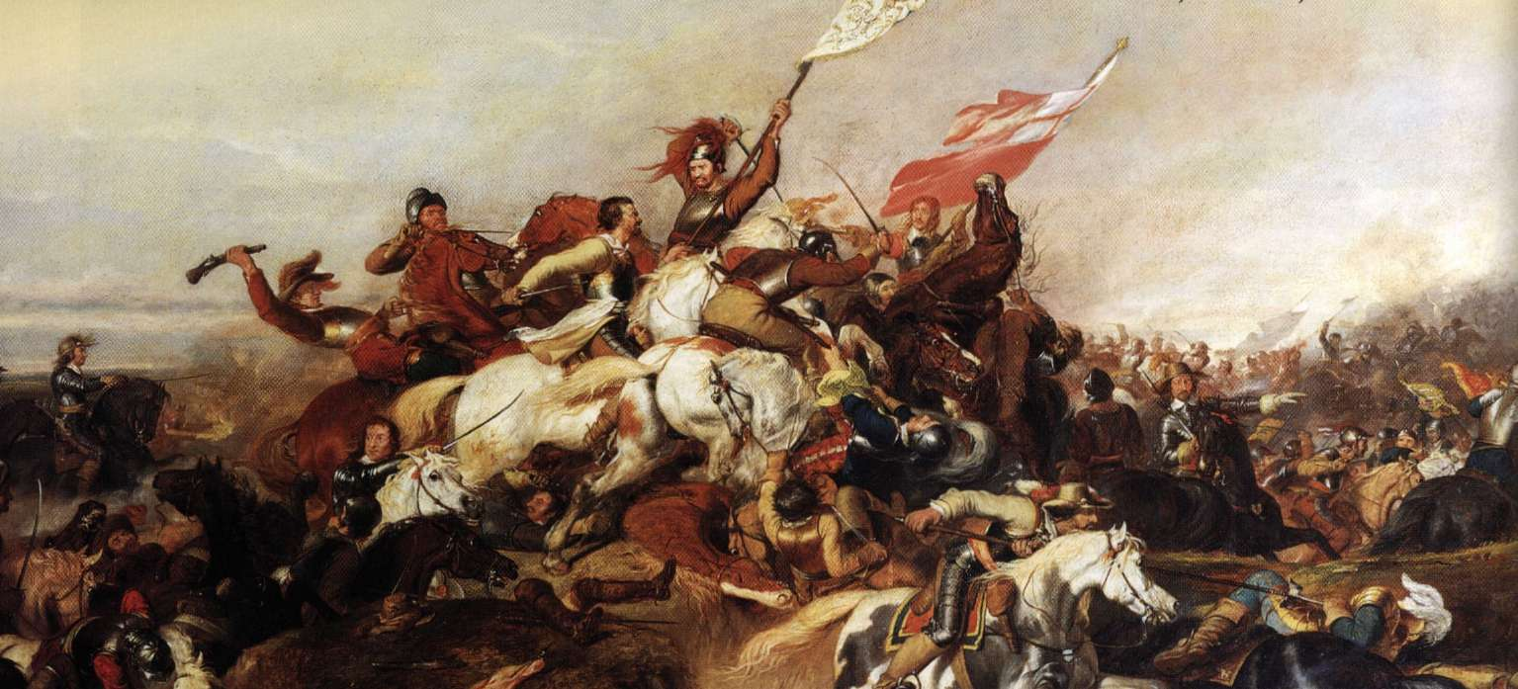
The English Revolution, 1625 – 1660 Private Study and Deeper Learning Guide.
Component 2 Depth Study
for AQA A-Level History

Slide 2
The English Revolution, 1625 - 1660
The following guide provides a number of ways for you to maximise and deepen your learning in your A-level History Unit on the English Revolution. Many of these tasks should be completed in Private Study (PS) in addition to any homework tasks you have been set. You can use the core textbook and other key books available in the school library, as well as the following websites, to support you.
http://spartacus-educational.com/Stuarts.htm - Useful summaries and overviews. Some good sources too.
http://www.historylearningsite.co.uk/stuart-england - Good basic overviews.
http://nationalcivilwarcentre.com/nationalcivilwartrail/ - A really good website for the National Civil War Centre. The App is excellent! Download it onto your phone or tablet!
http://bcw-project.org/ - Awesome reference site to look up key individuals and events
http://www.british-civil-wars.co.uk/search.htm - Another amazing reference site to look up key individuals and events!
http://www.aqa.org.uk/subjects/history/as-and-a-level/history-7041-7042/teaching-resources
AQA Exam Board link to materials such as course specification, past papers etc.
WHAT DO YOU NEED TO DO?
As a student of History, you need to live your subject. Beyond all of the set work, we expect you to be using free periods to be completing tasks from this booklet and the resources we provide and that are out there on the internet and in the library. A few key general things that you should focus on doing regularly are:
As you complete each topic make sure your notes are organised and up to date in your folder under the headings to the left.
As you complete each topic produce a summary diagram for each one covering the key ideas, events and details from that topic/period.
Useful Revision Extension –. You should also create sets of revision cards and timelines covering the key events and case studies from each Topic.

Slide 3
Going Deeper – PS Tasks to extend and deepen your Knowledge
Whilst studying each unit try to complete as many of the PS tasks set below as possible. You may also like to dip into the recommended reading to gain a sense of the historian’s opinion on the topic and some extra depth/detail to your understanding.
Section 1) The Emergence of conflict and the end of the consensus,1625-29
Task 1 Research the following characters. Create a short biography/factfile on each, including info on their views, roles and life
- James I
-Charles I
- George Villiers, Duke of Buckingham
- Queen Henrietta Maria (Charles I’s wife)
- Key opponents of the King: Eliot, Digges and Coke
Task 2 Research the following religious beliefs and write a short summary pointing out the key differences:
- Catholicisim, Protestantism, Puritanism and Presbyterianism
Task 3 Write a definition of Divine Right
Task 4 Create a factfile of each of the three Parliaments 1625-29. Use pp.213-219 of the Flagship Text Book, Britain 1558-1689, to help you.
Task 5 Create a timeline of the key events 1625-29. (Use the text book to help, or the Flagship Text Book, Britain 1558-1689, to help you)
Task 6 Draw simple diagrams to show the following systems:
- Stuart Governemnt and Parliament
- The Church of England (Flagship Textbook, Britain 1558-1689, p171)
- The Tax System (Wheeley textbook p.14)
Task 7 READING: Please read the following sections and take some notes as you do so.
- C. Hibbert, Charles I, pp.63-96 on Charles and Henrietta Maria
- C. Hibbert, Charles I, pp.96-112 on Religion in England
- J. Miller, The English Civil Wars, pp.21-39 on Charles’ early years
- D. Smith, A History of the Modern British Isles, Sections 1, 2 and 3 of Chapter 4 ‘The Personal Rule of Charles I’ (pp.80-91)

Slide 4
Section 2) An Experiment in Absolutism, 1629-40
Task 1 Research the following characters. Create a short biography/factfile on each, including info on their views, roles and life
- Thomas Wentworth (later Earl of Strafford)
- William Laud, Archbishop of Canterbury
- Richard Weston, Lord Treasurer
- John Pym (for the Puritan network of which he was a part – see the AQA Oxford Textbook The English Revolution pp.50-51 and 78-79)
- John Hampden
- Richard Montagu
- Burton, Prynne and Bastwick
Task 2 Write a short definition of ‘The Divine Right of Kings’. Reflect on why this may cause problems for English Parliaments.
Task 3 Make a list/spider diagram of all the different ways that Charles financed the Personal Rule (include definitions/details/amounts for each method). This information can be found on the given websites, the Wheeley text book, but also p.220-221 of the Flagship Text Book, Britain 1558-1689
Task 4 What was ‘Thorough Government’? Write a short definition of what this term means.
Task 5 Make a list/spider diagram of all the different Laudian Reforms (include definitions/details/amounts for each method). This information can be found on the given websites, the Wheeley text book, but also p.223-225 of the Flagship Text Book, Britain 1558-1689; pp.45-53 of the AQA Oxford Textbook The English Revolution.
Task 6 Research Opposition
Task 7 Create a timeline of the Bishops Wars, 1637-40.
Task 8 READING: Please read the following sections and take some notes as you do so.
- J. Miller, The English Civil Wars, pp.41-67 on Thomas Wentworth, Earl of Strafford
- D. Smith, A History of the Modern British Isles, Sections 4, 5 and 6 of Chapter 4 ‘The Personal Rule of Charles I’ (pp.91-104)
- The Flagship Text Book, Britain 1558-1689, pp.225-227 on Charles’ rule in Scotland and Ireland.
- C. Hibbert, Charles I, pp.138-147 on the Personal Rule
- Angela Anderson, The Civil Wars, p1-17 – a very simple/general overview of the period
- D. Purkiss, The English Civil War: A people’s history, pp.71-97 on the Bishops Wars; and pp.98- 120 (Don’t worry about taking notes on this at first – it is a challenging, but hugely rewarding piece of reading – A BRILLIANT WAY TO STRETCH YOURSELF)

Slide 5
Section 3) The Crisis of Parliament and the Outbreak of the First Civil War, 1640-42
This is a very detailed period of the course and it is important for you to understand this on a month by month basis. The timelines on the websites recommended at the start of the booklet will be really useful here. You can also use the following to help master this vital period.
Task 1 Research the following key events. Create a short factfile on each:
- The Short Parliament
- The Long Parliament
- The Impeachment of Laud and Strafford, and the Act of Attainder/Strafford’s execution
- The Root and Branch Petition
- The Grand Remonstrance
- Irish Rebellion
- Attempted Arrest of the 5 MPs
Task 2 Analysis Task: Who was more to blame for the rising tensions across this period? Create two lists of evidence that show the King or Parliament to be at fault.
Task 3 Research a brief fact file on the Duke of Bedford. Focus on his attempts to bring Crown and Parliament together. How significant was his death?
Task 4 Read Angela, Anderson, The Civil Wars, p28-33. This is an overview of what historians have said about this period. Summarise the different viewpoints.
Task 5 READING: Please read the following sections and take some notes as you do so.
- P. Gaunt, The English Civil Wars, 1642-1651, pp.19-23 for a superb overview of the lead up to the course.
- J. Miller, The English Civil Wars, pp.69-94 on The Grand Remonstrance
- D. Smith, A History of the Modern British Isles, Chapter 5 ‘The Collapse of Multiple Monarchies’, pp.110-130)
- The Flagship Text Book, Britain 1558-1689, pp.228-234 for an overview of the period. In addition, p.234-235 gives a good source analysis task that you can complete.
- C. Hibbert, Charles I, pp.148-182 for another excellent overview on the decline into war
- Angela, Anderson, The Civil Wars, p20-51 – a very good overview of the period that helps by picking up key points
- D. Purkiss, The English Civil War: A people’s history, pp.121-139 on the decline into war from a people’s perspective. (Don’t worry about taking notes on this at first – it is a challenging, but hugely rewarding piece of reading – Another BRILLIANT WAY TO STRETCH YOURSELF)

Slide 6
Section 4) War and Radicalism, 1642-46
This section deals with the war itself – its impacts and reasons for its outcome.
Task 1 Research the following key events/things. Create a short factfile on each:
- Battles of: Edgehill; 2nd Newbury; Marston Moor; Naseby.
- Solemn League and Covenant
- Self-Denying Ordnance
- The New Model Army
Task 2 Research the following characters. Create a short biography/factfile on each, including info on their views, roles and life
- Prince Rupert
- Sir Thomas Fairfax
- Oliver Cromwell
- Edward Montagu, Earl of Manchester
- Robert Devereux, Earl of Essex
- Alexander Leslie (later 1st Earl of Leven)
Task 3 Read Angela, Anderson, The Civil Wars,, pp.76-79. Did the Royalists lose or the Parliamentarians win the war? Summarise the reasons for your choice.
Task 4 Read Angela, Anderson, The Civil Wars,, pp.80-88. Create a brainstorm of all of Parliaments’ strengths in the war.
Task 5 Read P. Gaunt, The English Civil Wars, 1642-1651, pp.63-65 and 75-80. Contrast the soldiers stories with those of the civilians. What ways were they similar and different. How far did the war affect every day life
Task 6 Read The Flagship Text Book, Britain 1558-1689, pp.256-60 which looks at Radicalism in the Civil War. Consider the 3 questions on p. 260.
Task 7 READING: Please read the following sections and take some notes as you do so.
- P. Gaunt, The English Civil Wars, 1642-1651, pp.66-74 for a wider look at the war
- J. Miller, The English Civil Wars, pp.95-118 (Extension – you could read onto Chaper 6 to look at the impact on people. It can be compared to D. Purkiss below)
- D. Smith, A History of the Modern British Isles, pp.137-147
- The Flagship Text Book, Britain 1558-1689, pp.237-255 for an overview of the War.
- C. Hibbert, Charles I, pp.183-241 for another excellent overview of war
- D. Purkiss, The English Civil War: A people’s history, Chapters 8 – 27 on the impact of war from a people’s perspective. Each Chapter takes a different angle, so you can pick and choose. (Don’t worry about taking notes on this at first – it is a challenging, but hugely rewarding piece of reading – Another BRILLIANT WAY TO STRETCH YOURSELF)

Slide 7
Documentaries and Films
The below are films you could watch to extend your understanding of the period. For each one you will need to consider what it says about the period it was filmed in i.e. what can we learn about Hollywood’s and public attitudes from it? Secondly where it is based on real events how accurate is it – what was the real story.
---------
Cromwell – (A great dramatization – but limited in its historical accuracy. Look at the wiki page on this film as it lists all of the inaccuracies as you watch!)
To Kill a King – (This is rubbish, but watch it and see what you think!)
--------
‘Blood on their Hands’ – A great Channel 4 Documentary. https://www.youtube.com/ watch?v=k7jfpgFdX2E
Battlefield Britain: Naseby – available on DVD and sometimes on Youtube.
A great documentary on Cromwell
https://www.youtube.com/watch?v=b6SM3PjexkU& index=2&list=PL6oforB7ir5LIr9-L0EiNObnAIq3LFZ04

