Slide 1
Last minute critical theory club

Slide 2
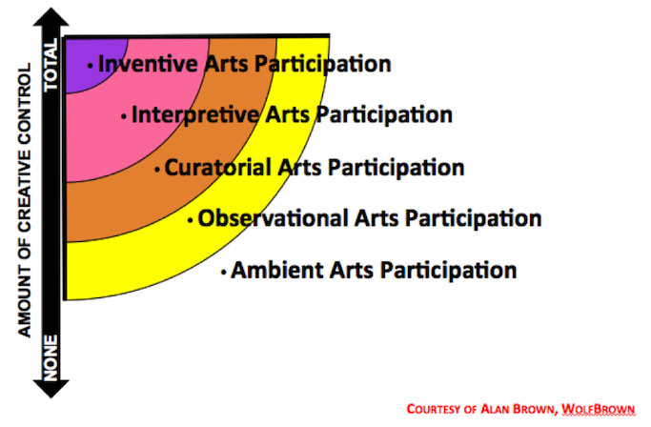

Slide 3
What are the five modes?
Inventive Arts Participation engages the mind, body and spirit in an act of artistic creation that is unique and idiosyncratic, regardless of skill level.
Interpretive Arts Participation is a creative act of self-expression that brings alive and adds value to pre-existing works of art, either individually or collaboratively.
Curatorial Arts Participation is the creative act of purposefully selecting, organizing and collecting art to the satisfaction of one’s own artistic sensibility.
Observational Arts Participation encompasses arts experiences that you select or consent to, motivated by some expectation of value.
Ambient Arts Participation involves experiencing art, consciously or unconsciously, that you did not select.

Slide 4
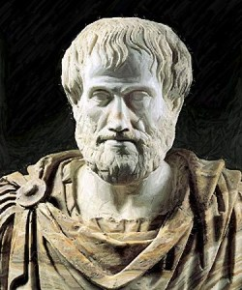
Aristotle and Catharsis
Catharsis = purgation
How this relates to the horror film:
Version 1
Fear poisons life with anxiety.
Catharsis can flush this feeling from our systems, bring it into the open, and clear the air.
This may explain the appeal of horror movies: they redirect our fears toward something external, grotesque, and finally ridiculous, in order to puncture them.
In this sense of purgation, the horror movie is a kind of medicine that does its work and leaves the soul healthier

Slide 5
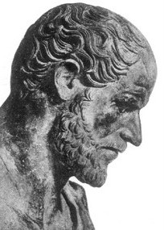
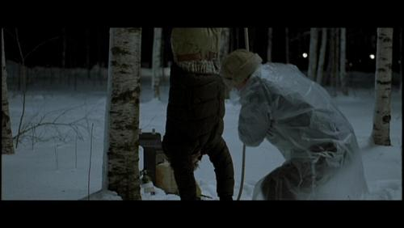
Version 2
On the other hand, fear might have a secret allure, so that what we need to purge is the desire for the thrill that comes with fear.
The horror movie provides a safe way to indulge and satisfy the longing to feel afraid, and go home afterward satisfied; the desire is purged, temporarily, by being fed.
In this sense the emotional experience of film is a potentially addictive drug.

Slide 6
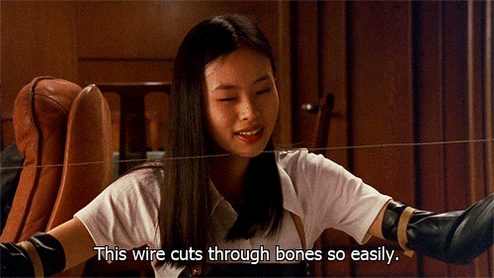
‘Torture porn’
Cinema allows us vicarious access to forbidden behaviour
Go on – link this to Jaques Lacan and mis-recognition or to Laura Mulvey and the mechanics of male identification.

Slide 7
Subjective camera and violence on screen

Slide 8
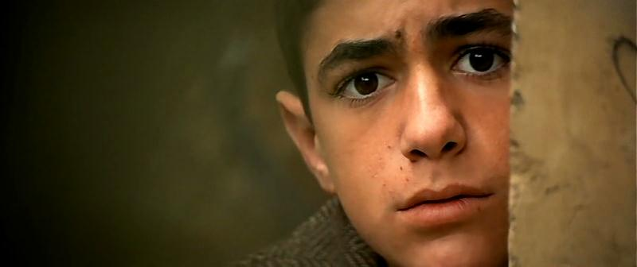
SCOPOPHILIA
Are we being permitted to give rein to a type of human interest in others that might more normally be considered socially unacceptable?
If so, what sorts of emotion do we experience at this point?

Slide 9
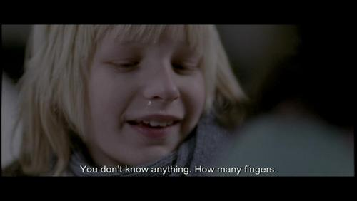
Either explanation may account for the popularity of horror movies among teenagers, since fear is so much a fact of that time of life.
For those of us who are older, the tear-jerker may have more appeal, offering a way to purge the regrets of our lives in a sentimental outpouring of pity.
As with fear, this purgation too may be either medicinal or drug-like.

