Slide 1
Energy Revision
Use this PowerPoint in addition to your exercise book to help you revise.

Slide 2
What you need to know
Types of energy (non-renewable & renewable)
Your personal energy consumption
Carbon footprints
Global energy consumption and reasons for varying use
Gulf of Mexico oil spills: causes, effects and responses
Acid rain: causes, effects and responses
Global warming: causes, effects and responses
Solutions to the energy crisis

Slide 3
Types of energy
Non-renewable | Renewable
Oil Coal Gas Nuclear Wood Non-renewable energy sources | Solar Wind Wave Tidal Geothermal Biomass Wood Renewable energy sources

Slide 4
Your personal energy consumption
How do you use energy?
Do you think you use too much?
How could you improve your energy use?

Slide 5
Carbon footprints
Carbon footprint is the sum of all the greenhouse gases (e.g. carbon dioxide)that are created by a person, company, event or product.
Make sure you know what they are and why we need to reduce our footprints
Carbon footprint revision website

Slide 6
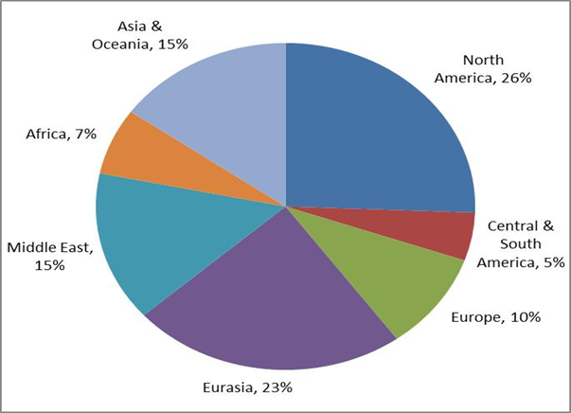
Global energy consumption

Slide 7
Basic reasons for global energy consumption
North America: rich so can afford to use lots of energy and buy technology that uses energy
Europe: rich so can afford to use lots of energy and buy technology that uses energy
Asia: huge population so uses lots of energy but not very rich
Australasia: wealthy but very small population so doesn’t use much energy
South America: poorer area so can’t afford to buy lots of things that use lots of energy
Africa: very poor so can’t afford to import energy or buy things that use lots of energy

Slide 8
Gulf of Mexico Oil Spill
You need to know the causes, impacts and responses to the oil spill.
Gulf of Mexico Bitesize Revision
Gulf of Mexico BBC news report

Slide 9
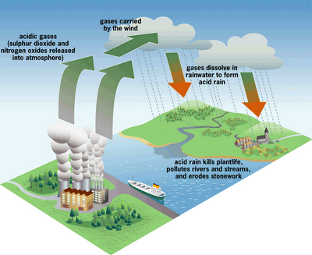
Acid rain
You need to be able to explain the causes, impacts and responses.
Acid rain revision website

Slide 10
Global Warming
You need to know the causes, impacts and responses.
Global Warming - None like it hot!
Greenhouse Effect explanation

Slide 11
Solutions to the energy crisis
What should we do about our future use of energy?
Which types of energy is going to run out?
Which types of energy are damaging our planet?
How do you think we should change our energy use?

