Slide 1
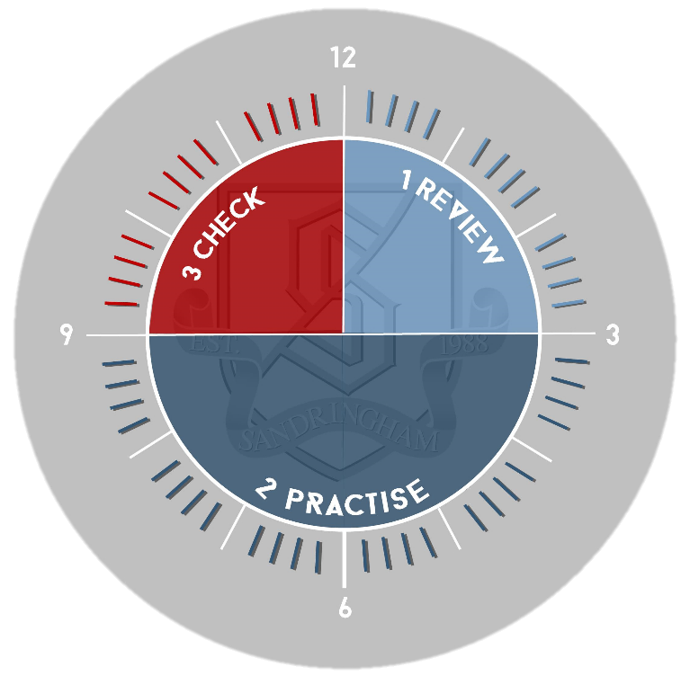
US History: Reconstruction Review
Review:
Look through your notes from the RECONSTRUCTION 1865-1877 section of the course. Briefly jot down the aims of reconstruction and then
As you go over your notes create a pros/cons chart of how successful Reconstruction was under the headings Politically/Socially/Economically in order to summarise what you have learnt so far. Make sure you include key examples.
3. Check
Go back to your notes and summary table to check you have included all the points you wanted to in your paragraph. Use a green pen to add improvements / additional information as necessary.
2. Practise:
Without looking at the summary table you have created Sheet, write out one key example of success and one key example of failure for each of the three categories Political/Social/Economical
Look back at the overview sheet. Add missing info if necessary.
NEXT Without looking at your notes, write up paragraph focused on one of the three headings in answer the following question:
How successful was Reconstruction?

