Slide 1
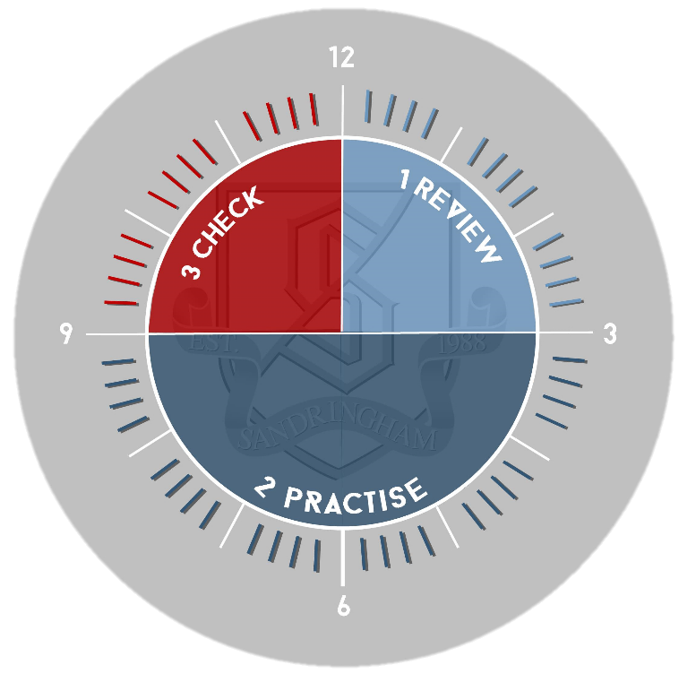
US History: Reconstruction Review
Review:
Look through your notes from the Westward Expansion section of the course. As you go over your notes create a list of factors that drove expansion in order to summarise what you have learnt so far. Make sure you include key details to support.
3. Check
Go back to your notes and summary to check you have included all the points you wanted to in your paragraph. Use a green pen to add improvements / additional information as necessary.
2. Practise:
Without looking at the summary you have created, list the factors for Westward Expansion placing them in a rank order of importance
Look back at the overview sheet. Add missing info if necessary.
NEXT Without looking at your notes, write up paragraph focused on explaining the most important reason for Westward Expansion.

