Slide 1
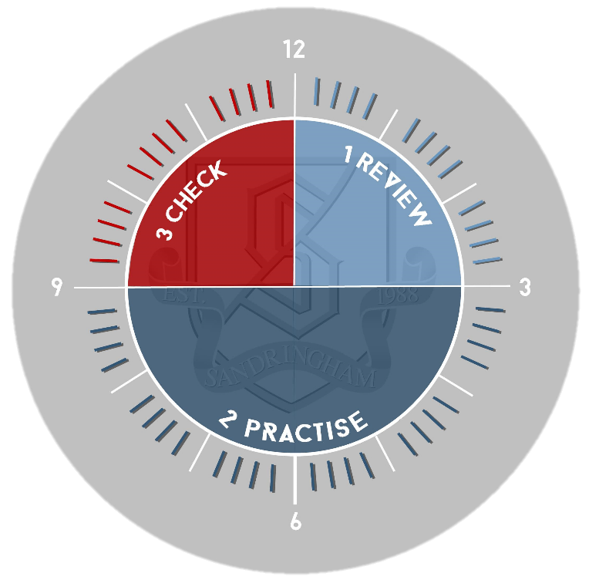
History Component 2
Review: Look through your notes from the INTRODUCTION section of the course. Complete the 6 boxes on the Overview Sheet to summarise each of the key areas studied so far
3. Check
Go back to your notes and Overview Sheet
Use green pen to add improvements / additional information as necessary
2. Practise:
* Without looking at the Overview Sheet, write out one key example of stability and one key example of crisis for each of the three categories (Religion, Political Powers and Foreign Policy)
* Look back at the overview sheet. Add missing info if necesary.
* Without looking at your notes, write a paragraph to answer the following question:
How close to crisis was England by 1625?

